Slide 1

Technical Democracy
Giving data users a fair seat at the EDM table

Slide 2




This paper comes from a collaboration between data users and data scientists...
This is a hard thing to do!
Kirsty Kitto Educational Data Science
Kalervo Gulson Sociologist of Education
Greg Thompson Sociologist of Education
Leonie Payne Educational Data Science

Slide 3

What would fairness look like in educational data science?
Fair algorithms?
Fair data?
Fair decisions?
Fair participation in design and delivery of solutions?
Fair outcomes in the world?
Transparency? Accountability?

Slide 4
Question 1: how can we achieve fairness in educational decisions without including domain experts in the design of the AI systems we would like them to use?
Question 2: but how can we give these domain experts an opportunity to participate in what is a highly technical process?

Slide 5

The problem of displacement
One of the biggest problems facing educational practitioners is one of ‘displacement’, caused by the widening gap between the data experts who create, analyse and make inferences based on data, and data users, who must make decisions using the reports that these experts create

Slide 6
The limits of expertise: Data users can’t do a Masters of Data Science
Displacement between data users and data experts leads to unequal status
Data users rarely know enough to know what they should be challenging
Data scientists are becoming the default decision makers - even if invited data users are not provided with an equal opportunity to challenge the analysis and its results (they lack the expertise required to fully participate)
Often the right answer is being given to the wrong question - the educational experts are not given the tools that they need to work this out

Slide 7
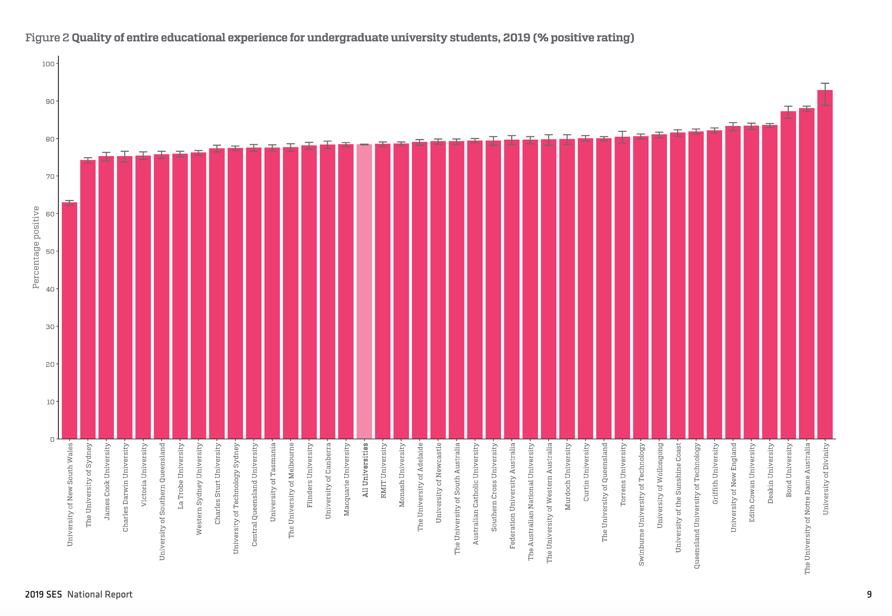
An example
What do these error bars mean?
Actually they are the right answer to the wrong question… but they instill inappropriate confidence in the findings!
Data analysis used for “evil”! But few data users know enough to challenge the output. And this is just for a simple confidence interval…
https://www.qilt.edu.au/docs/default-source/ses/ses-2019/2019-ses-national-report.pdf?sfvrsn=6486ec3c_2

Slide 8
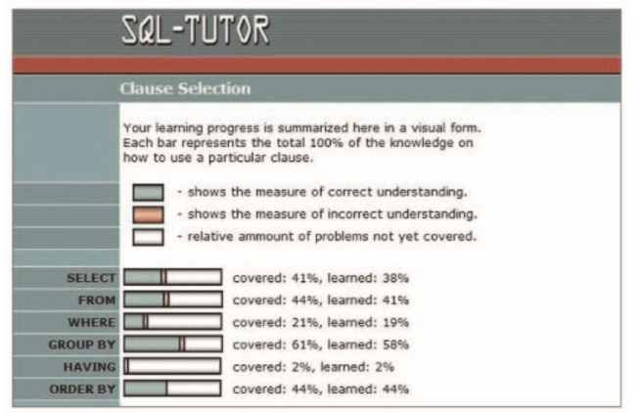

Where have (some of the) existing solutions got us?
Open learner models provide an interesting way in which to create more transparency in our models… but they give little control over what is actually reported (but they may help solve displacement over time by creating better understanding of models?)
Participatory design welcomes a data user into the process of design but says little about how they can bridge the displacement gap
Putting a human in the loop only works if they are given the resources to challenge the design decisions and their output

Slide 9
Technical Democracy is required
But how could it be achieved?
Data users need to be able to ask the right questions of technical solutions, and even more so, to challenge illegitimate approaches.
“to bring new actors into deliberation... [as] a redistribution of expertise in relation to a specific social context in which the authority bestowed on science-based knowledge is not a priori granted priority over experience-based knowledge with regard to a local problem”
Nunes, J. A., and M. Matias. Acting in an uncertain world: Essay on technological democracy. (2009). MIT Press

Slide 10
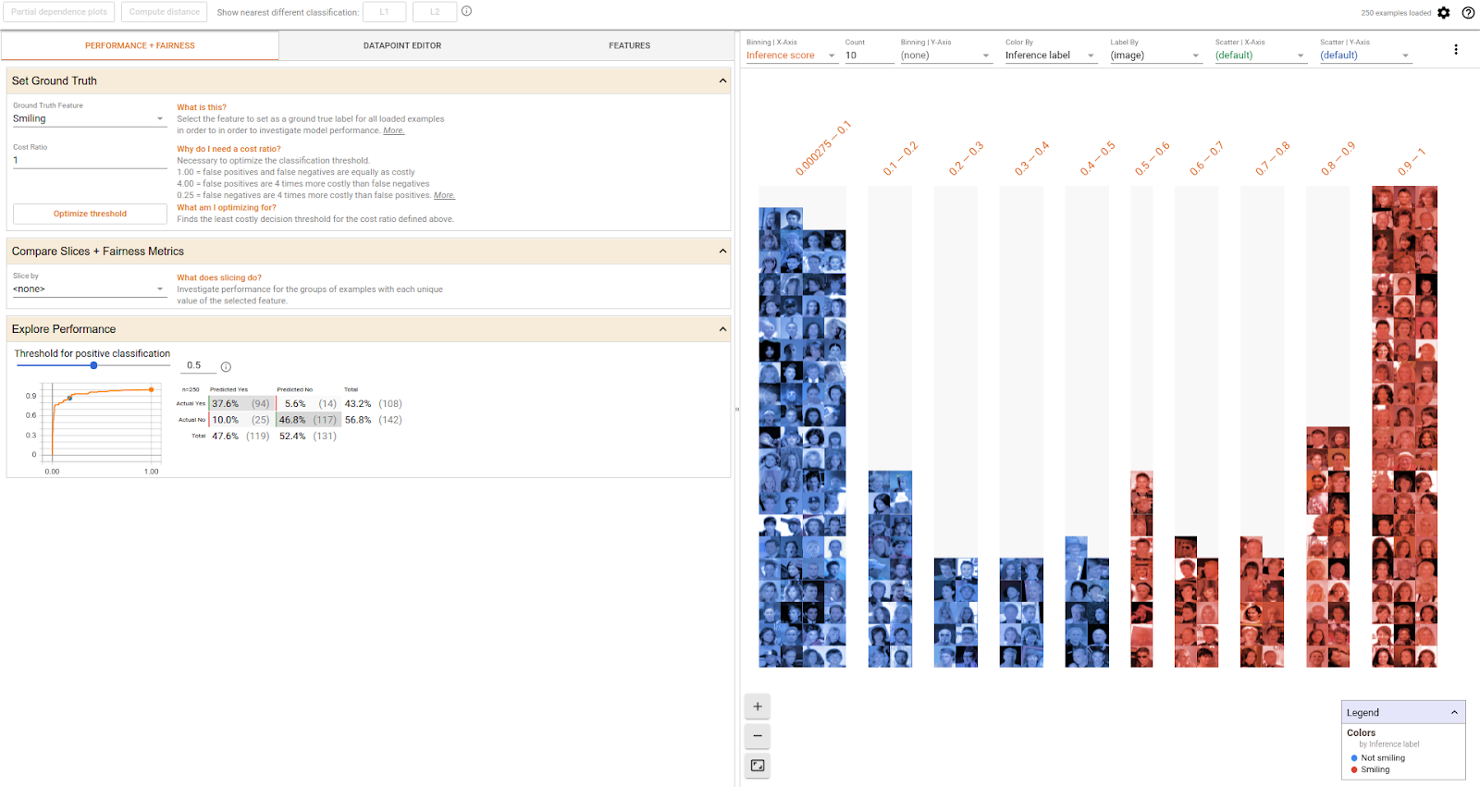
Data science ‘experiments’
We would like to explore methods to achieve technical democracy in educational decision making through data science ‘experiments’ that can help data users raise critical questions of highly technical algorithms…
In each experiment we want to:
Show how poor decisions are currently being made due to the use of inappropriately simple measures and decision criteria.
Demonstrate that better outcomes emerge from approaches based upon machine learning, BUT that each of these suffer from a lack of transparency (displacement)
Explore a way in which technical democracy could be achieved by helping data users to critically engage with the creation of an algorithm, and to challenge its output (technical democracy)

Slide 11
Experiments discussed in our paper
Decisions about school closures
Current problem: Political decisions not based on data (all schools closed in period were public)
Data: Schools closed in NSW from 2010-16, their NAPLAN performance data, and census data
Bayesian optimisation
What-If tool
Student evaluations of teaching
Current problem: Decision makers use averages and poor quality indicators
Data: QILT data
Monte Carlo resampling to address non-response bias
Dashboards for exploring how changing response patterns lead to non robust results

Slide 12
Thanks!
Questions we are asking ourselves (for discussion?)
This is a very preliminary proposal - what are we doing wrong?
This feels a lot like a learning gains problem… everyone starts at a different position so how can we really demonstrate displacement and its replacement by technical democracy?
How would we measure success?

